Slide 1
Inferential Statistics
GROUP_7

Slide 2
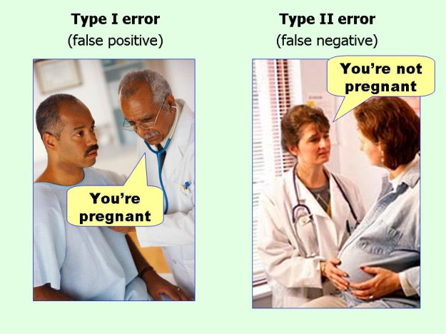

Slide 3
ERRORS IN HYPOTHESIS TESTING
TYPE ONE ERROR
TYPE TWO ERROR
Also known as “false positive”
This error occurs when one rejects a true null hypothesis.
For example making a conclusion that a new drug is effective when it actually has no effect.
Also known as “false negative”
This error occurs when one accepts a false null hypothesis.
For example making a conclusion that the new drug has no effect yet it actualy has an effect.

Slide 4
Type one errors
01

Slide 5



Type I Errors in Hypothesis Testing
01
02
Significance Level
Type I Error Rate
Probability of incorrectly rejecting a true null hypothesis.
Controlling the likelihood of making a Type I error.

Slide 6
01: Significance level
Significance level serves as a threshold in hypothesis testing to decide whether the results are statistically significant or not.
The commonly used threshold values 0.05 and 0.01 correspond to to a 1% and 5% respectively chance of rejecting the null hypothesis when it actually true.
The level of significance chosen depends on the context of the study, in very sensitive cases 0.01 is preferred otherwise 0.05

Slide 7
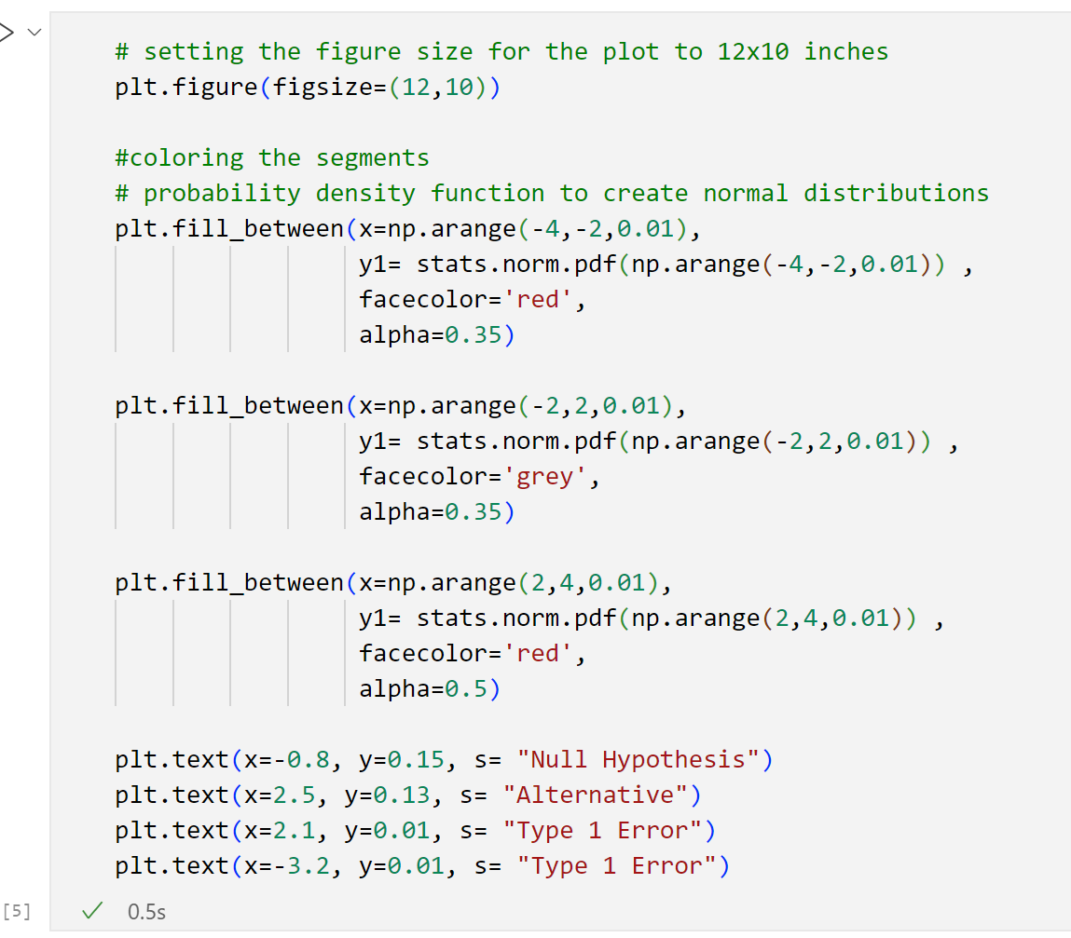
Visualising the type one error (The code)

Slide 8
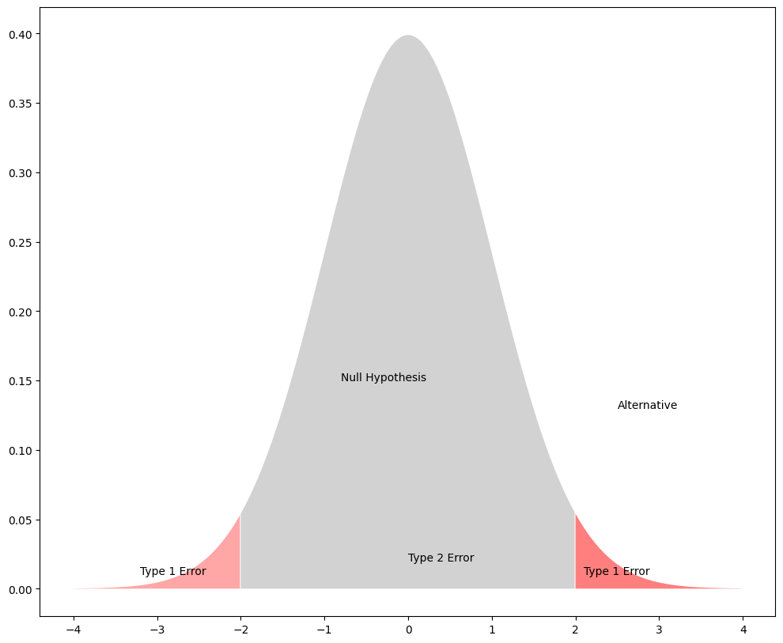
Visualization of the type one error

Slide 9
02: Type one error rate
Type one error rate is the probability of rejecting the null hypothesis yet it is true.
The significance level is a test put in place to keep the error rate low

Slide 10
Type two errors
02

Slide 11
Type II Errors in Hypothesis Testing
Probability of Failing to Reject Null
Factors Affecting Type II Error
Controlling Type II Error

Slide 12
02:Probability of Failing to Reject Null Hypothesis
If the null hypothesis is false then the probability of a type two error is denoted by “beta”
NOTE: A type two error simply implies that the data does not provide enough evidence for us to conclude that the null hypothesis is false.

Slide 13
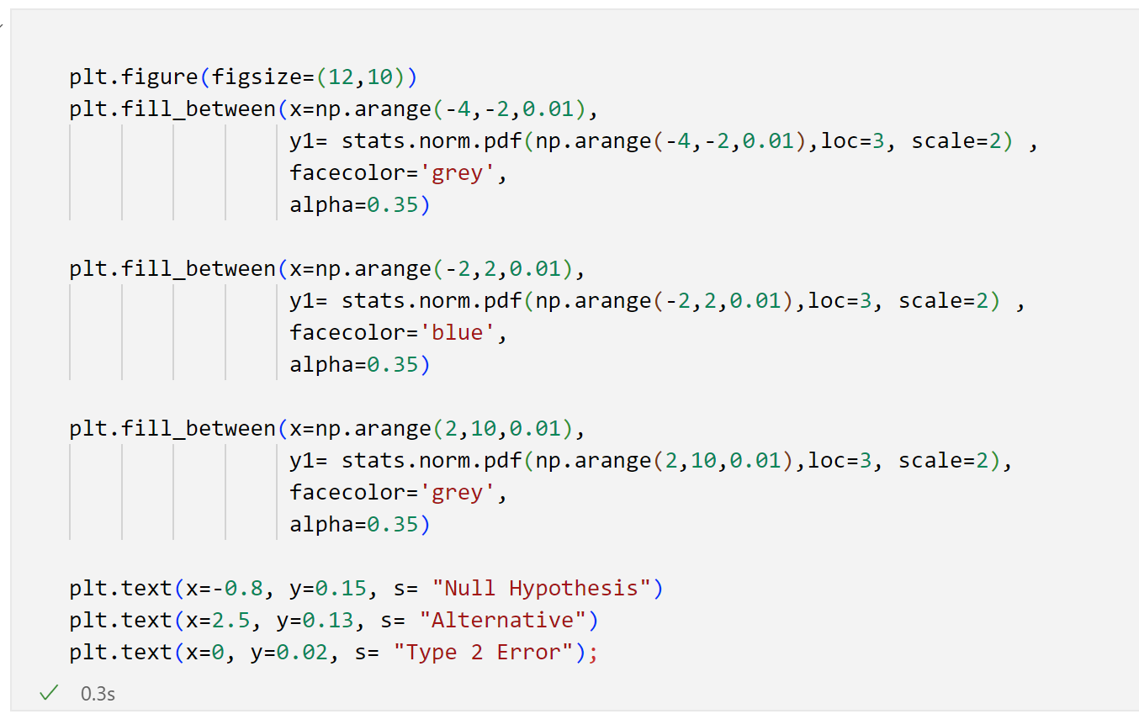
Visualising the type two error (The code)

Slide 14
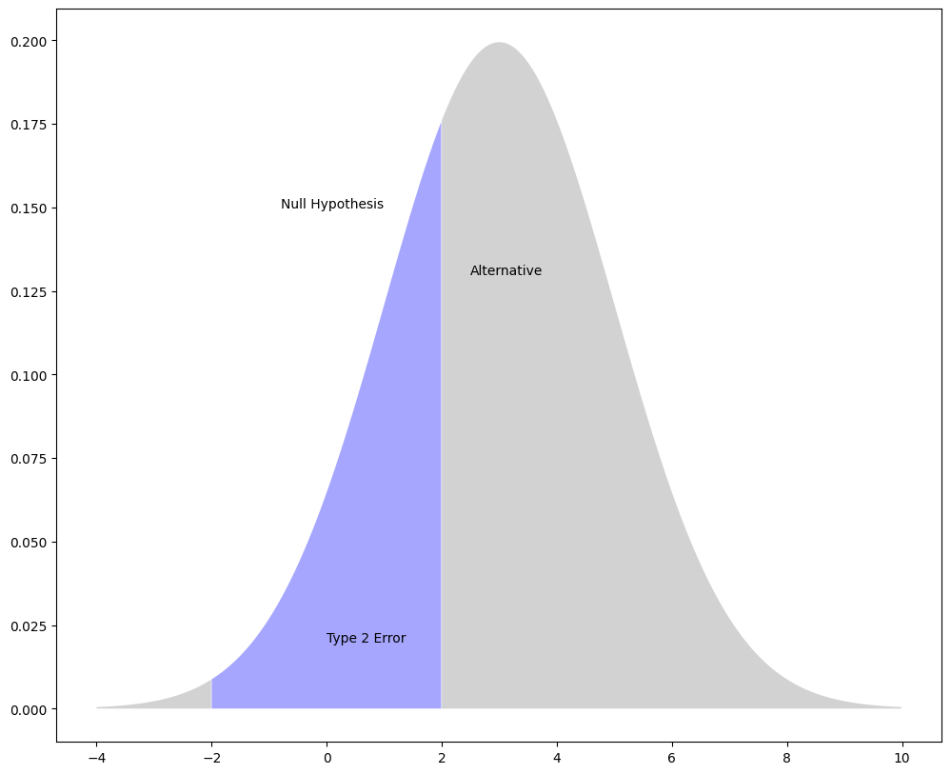
Visualization

Slide 15
02: Factors affecting the type two error
Sample size: A smaller sample size reduces the test’s ability to detect a true effect
Effect size: The smaller the true effect or difference, the harder it is to detect a type two error
Variability: Greater variability in the data can mask the effect being tested for
Significance level: Setting a low significance level makes it harder to reject the null hypothesis.

Slide 16
03: Controlling a type two error
Increase the sample space to provide more data for detecting an effect.
Use more precise measurement tools to reduce too much variations in the data
Design the experiment in such a way that the conditions are controlled and consistent
Adjust the level of significance

Slide 17
Mitigating statistical errors
03

Slide 18

Mitigating for Statistical Errors
Understand Significance Levels
Employ Robust Statistical Methods
Conduct Power Analysis
Determine appropriate alpha values to control Type I and II errors.
Use techniques like bootstrapping to reduce sensitivity to outliers.
Estimate required sample sizes to achieve desired statistical power.

Slide 19
RANDOM PROCESSES
A random process is a collection of random variables indexed by time or space.
Let N(t)be the number of customers who have visited a bank from t=9(when the bank opens at 9:00 am) until time t, on a given day, for t∈[9,16]. Here, we measure t in hours, but t can take any real value between 9 and 16. We assume that N(9)=0, and N(t)∈{0,1,2,...} for all t∈[9,16]. Note that for any time t1, the random variable N(t1)is a discrete random variable. Thus, N(t) is a discrete-valued random process. However, since t can take any real value between 9 and 16, N(t) is a continuous-time random process.

Slide 20
Types of random processes
A continuous-time random process is a random process {X(t),t∈J} where J is an interval on the real line such as [−1,1], [0,∞), (−∞,∞), etc.
A discrete-time random process (or a random sequence) is a random process {X(n)=Xn,n∈J}, where J is a countable set such as N or Z

Slide 21
Thank You
Name
MIREMBE PEACE MERCY .....M24B23/005
MUKIDI ANDREW......................M24B23/035
RAYMOND JAMES M................M24B13/047
EDEKEI JUSTIN WYCLIFF.......M24B38/012
WARUDATA NATUKUNDA...M24B23/023
SSUUBI STEPHEN.......................M24B13/007
IFEMENE PAUL............................M24B13/034
CHURCHILL OGENRWOT......M24B13/028
ANGELLA KYAZZE.....................M24B13/041

